Slide 1
Proposal Storyboard
Understanding/estimating C transport across flatwoods landscapes.
Can hydrologic management optimize C sequestration?
“Given that wetlands are intermediates between terrestrial and aquatic ecosystems and that their high CO₂ ﬂuxes are sustained by direct atmospheric CO₂ ﬁxation by emergent plants, we have chosen to exclude the direct ﬂuxes from our aggregate estimate.” (Drake et al 2018)

Slide 2
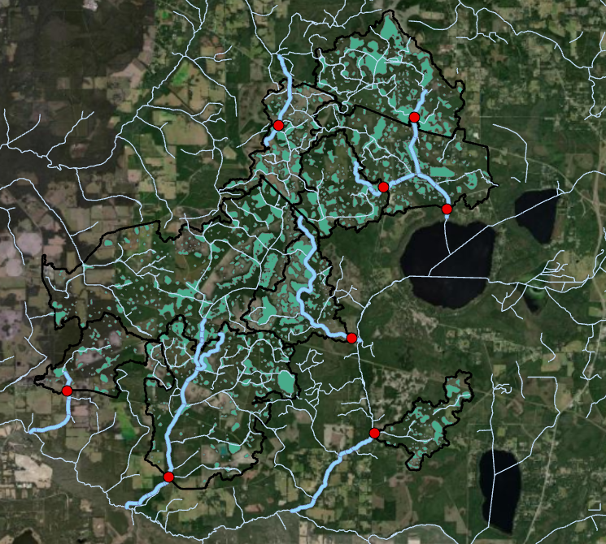
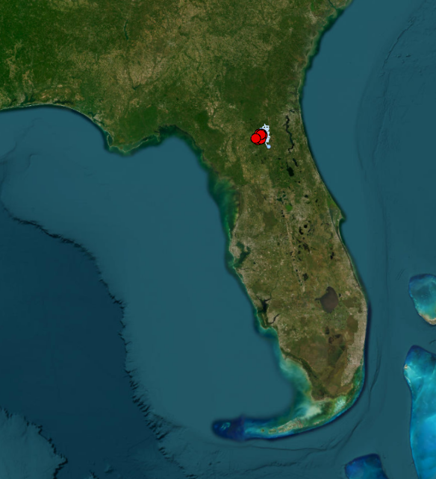


Sites
Streams
Wetlands
Basin Boundary
3725 m

Slide 3
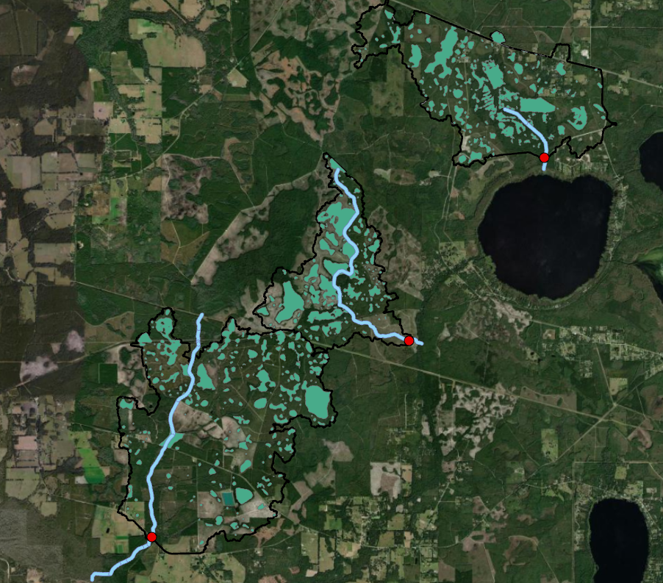
Bradford Forest
Sites
Streams
Wetlands
Basin Boundary
3725 m

Slide 4
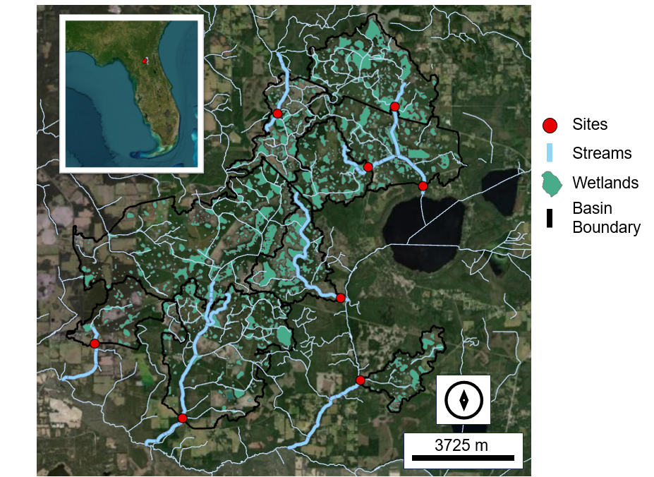
Bradford Forest

Slide 5
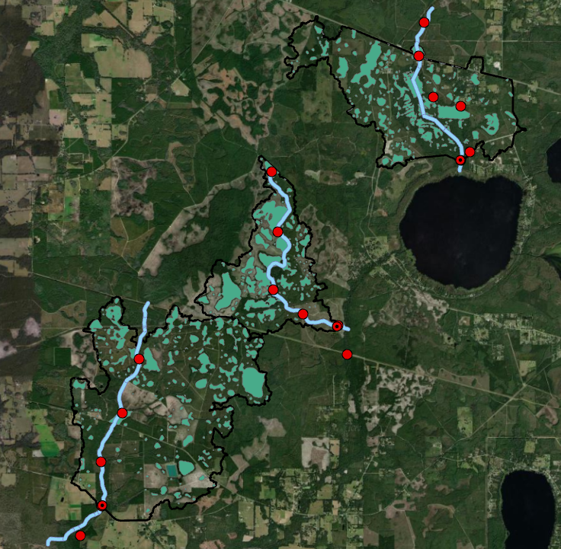
Bradford Forest
Sites
Streams
Wetlands
Basin Boundary
3725 m

Slide 6
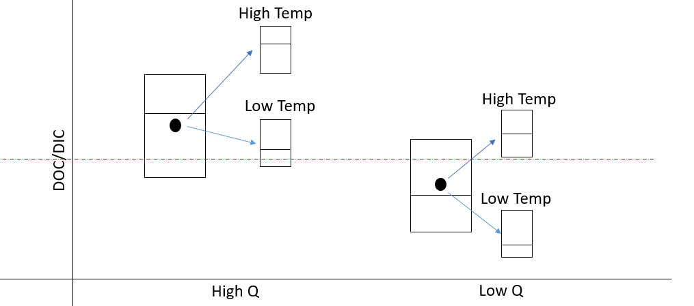
H1: Flatwood streams situationally flip between reactive and chimney pathways during high and low discharge (respectively).
*I hypothesize most C is DIC, namely in the from of dissolved CO₂
Greater DOC
Greater DIC
High Q:
Low Q:
Rainfall delivers great DOC.
DOC
DIC
Less external C inputs, low redox.
DOC
DIC
POC
POC

Slide 7
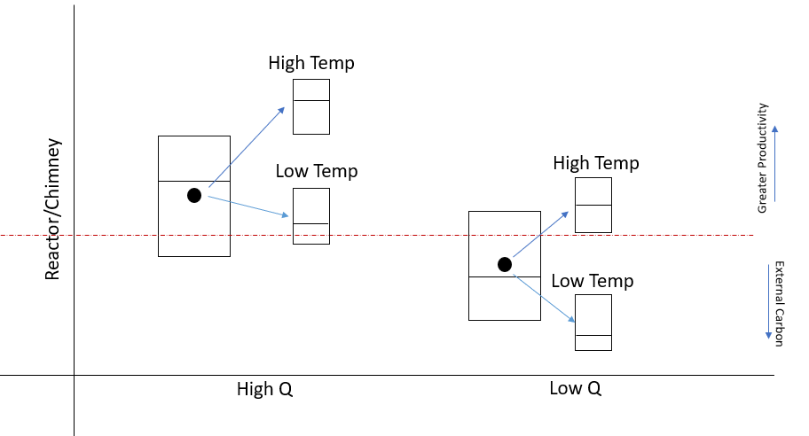
H1: The chimney pathway dominates in flatwood streams, but the reactor pathway becomes more prominent during baseflow conditions

Slide 8
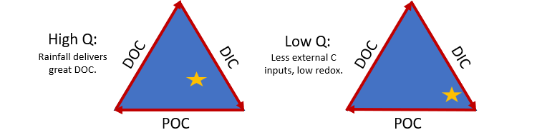
H4: I expect DIC is the dominant stream carbon species across flow regimes but DOC and POC will increase with increasing discharge.

Slide 9
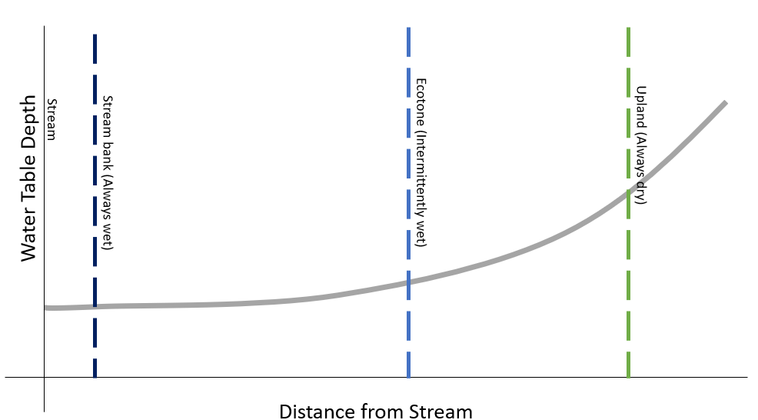
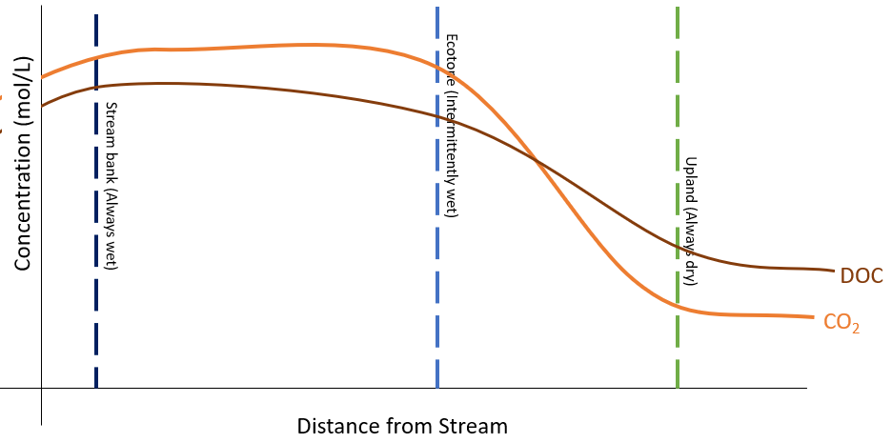
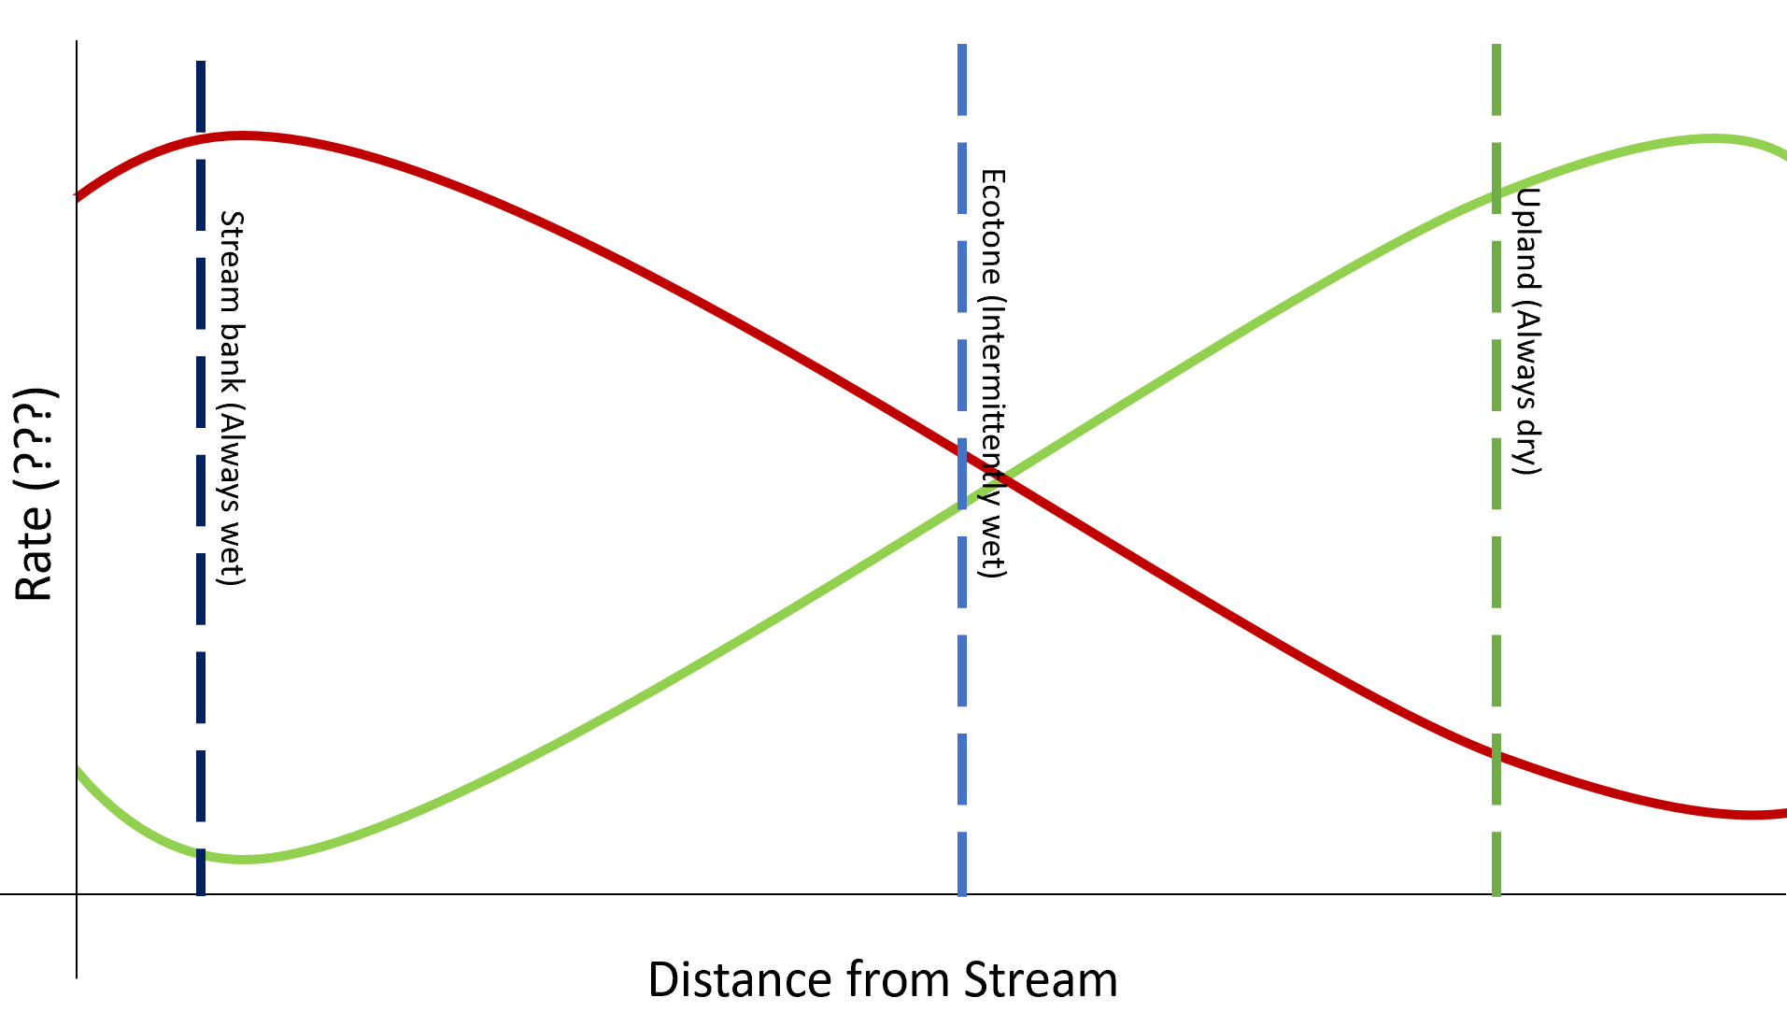
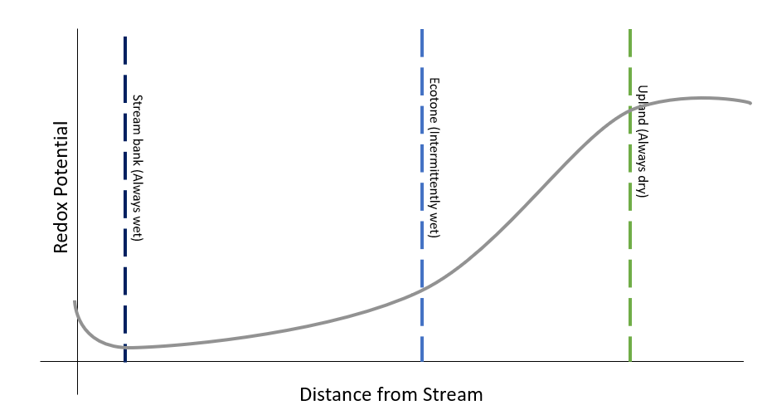
H2: The river corridor- the ecotone between the upland terrestrial landscape and the stream channel- delivers majority of the DOC to streams and is a significant carbon stock in flatwood landscape.

Slide 10
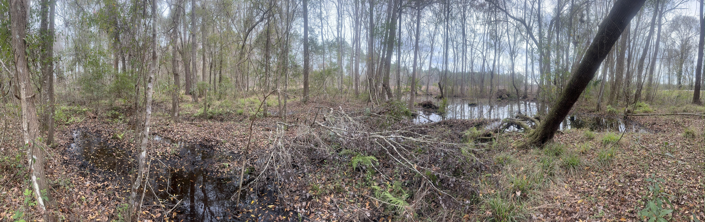
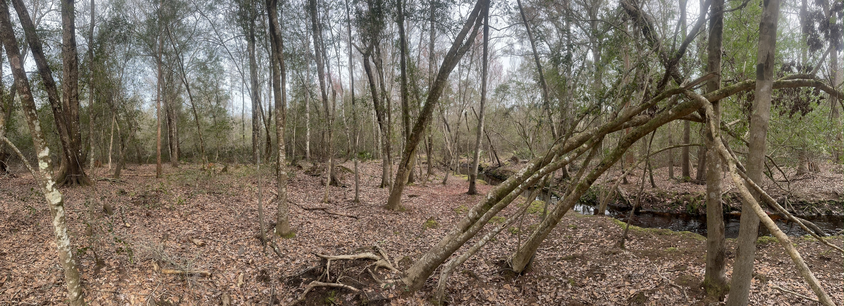
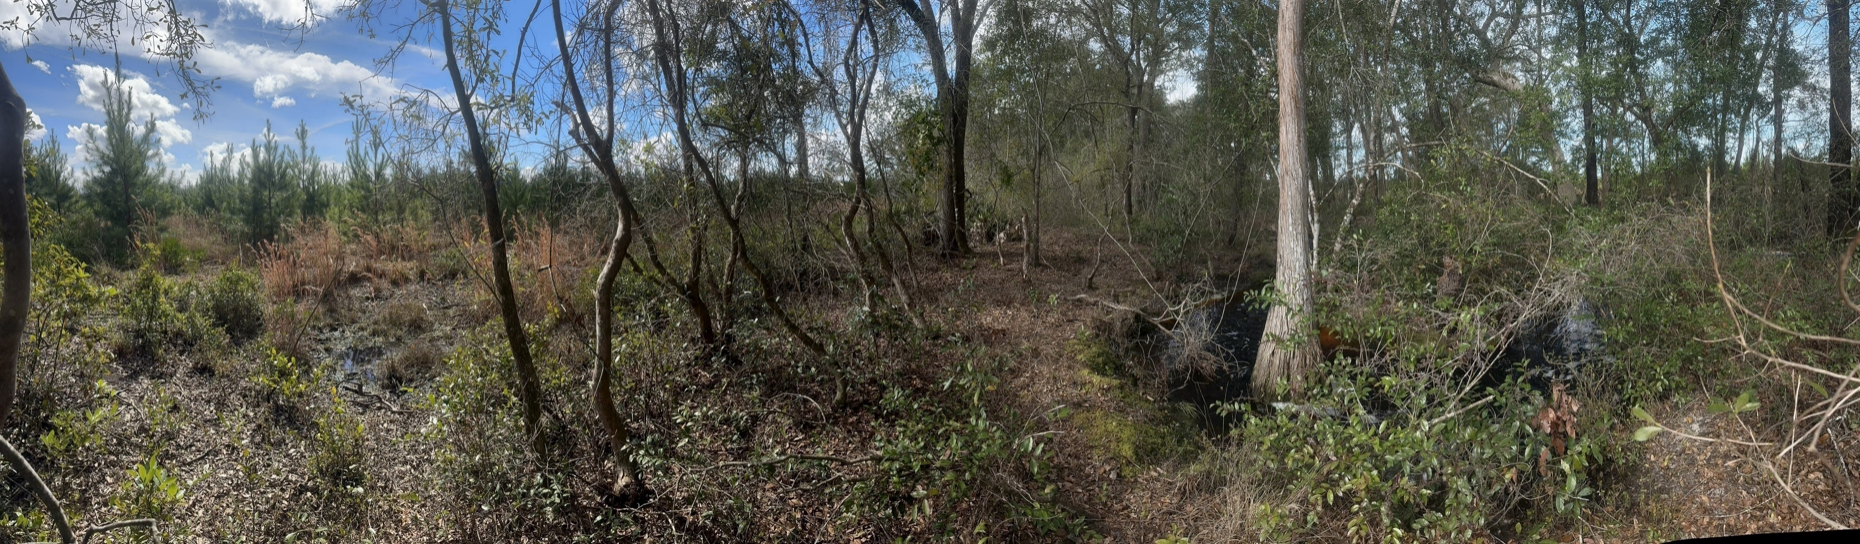
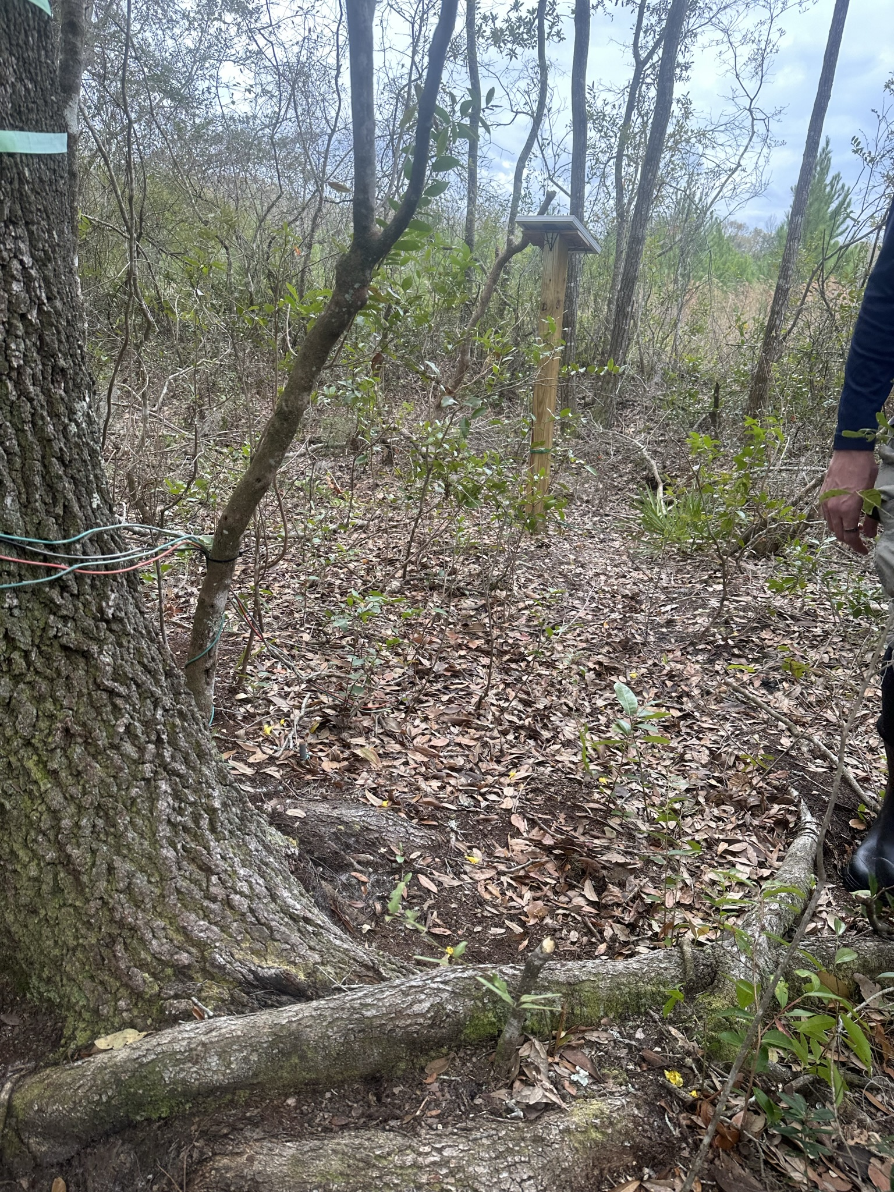
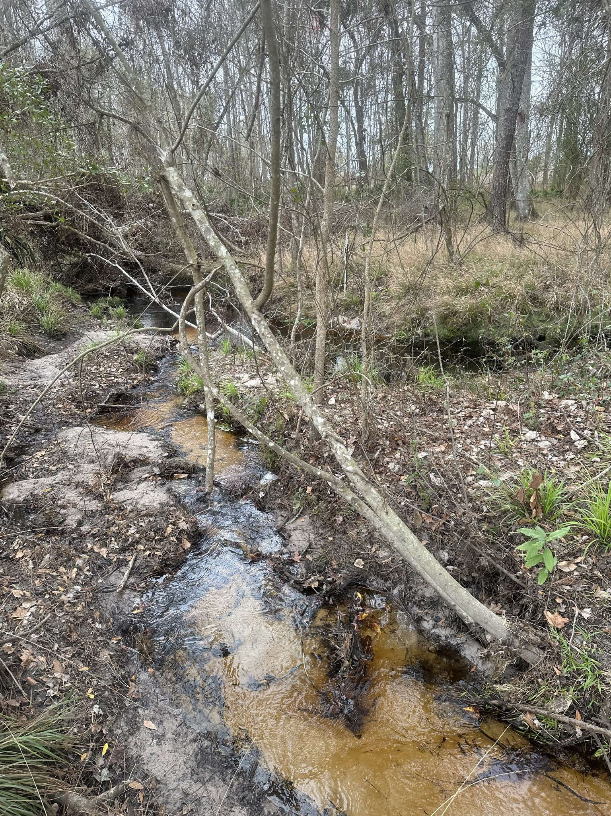
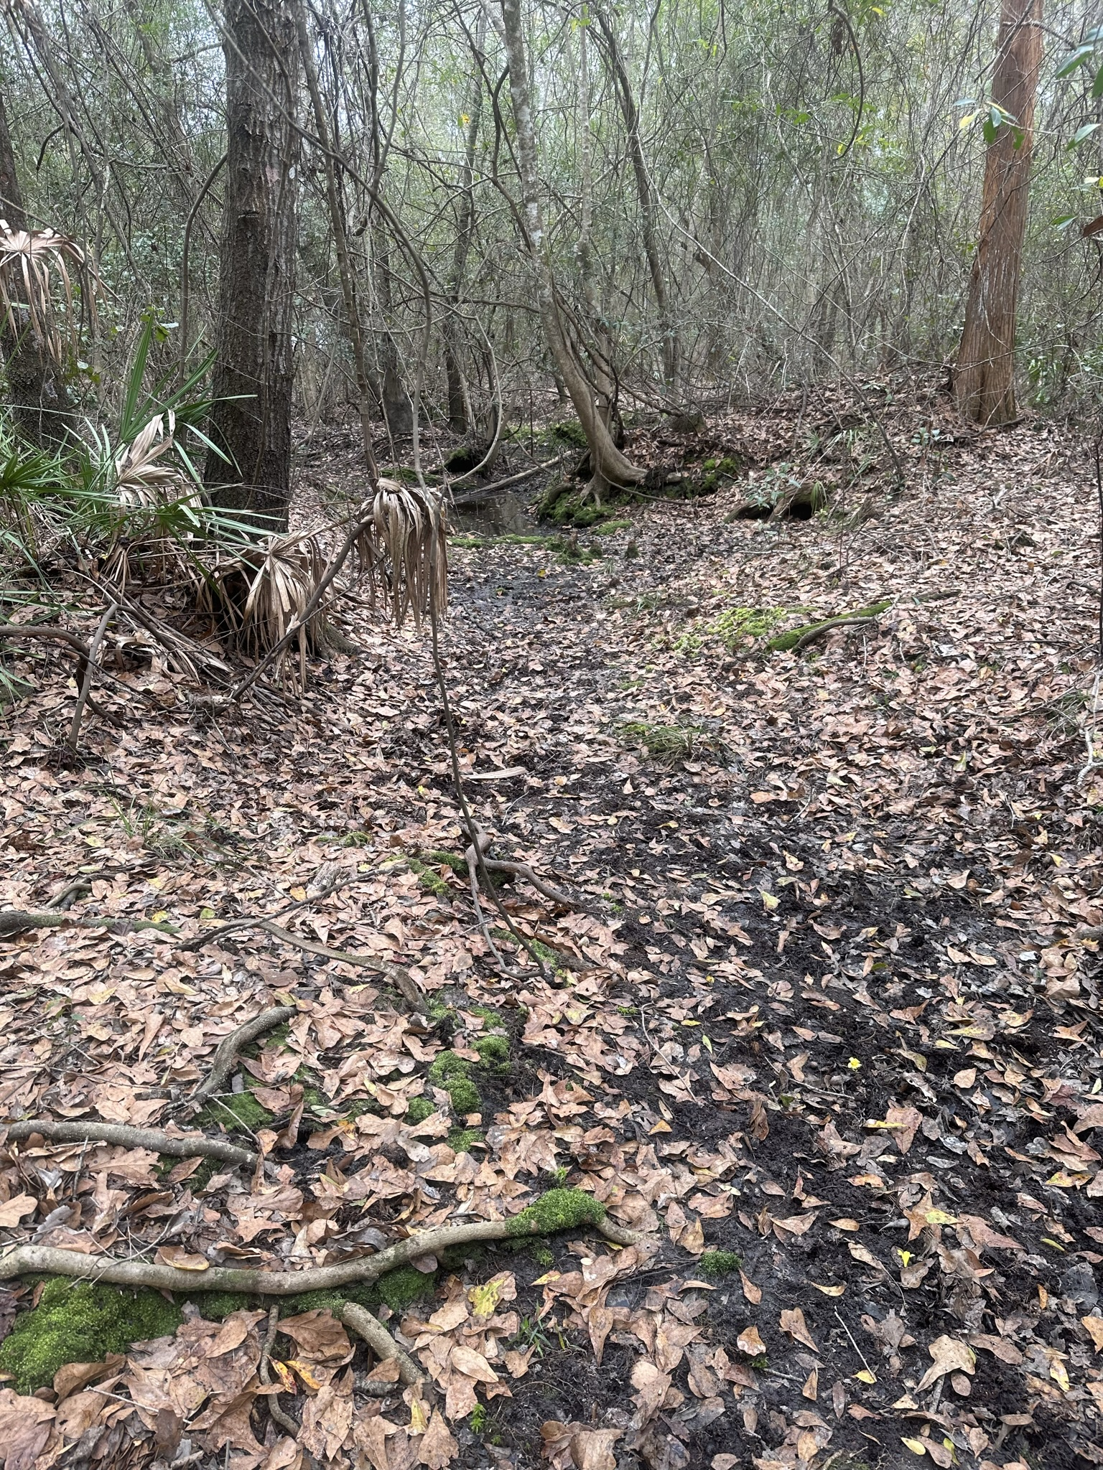
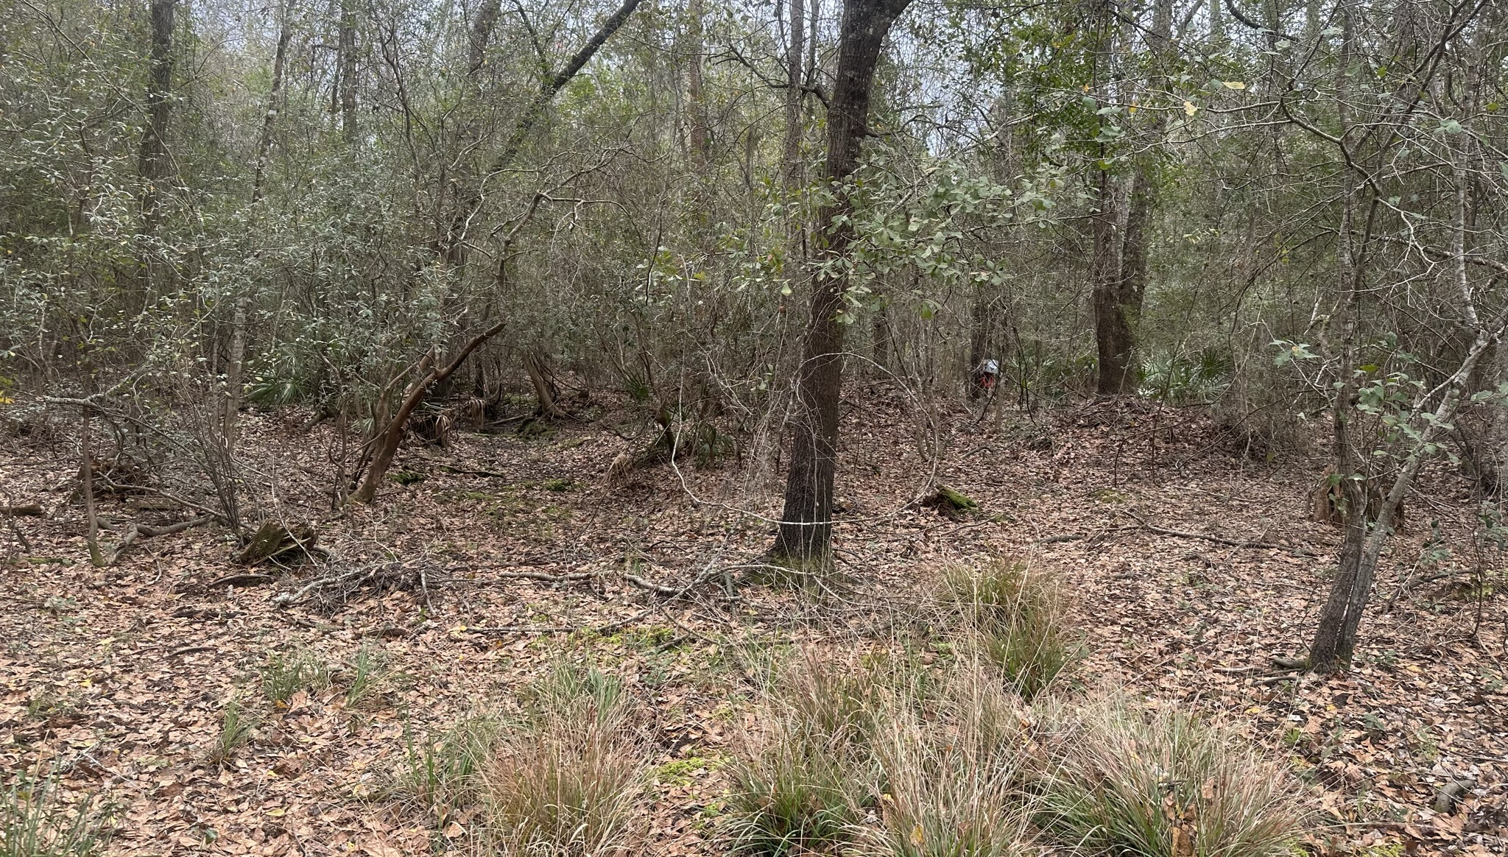
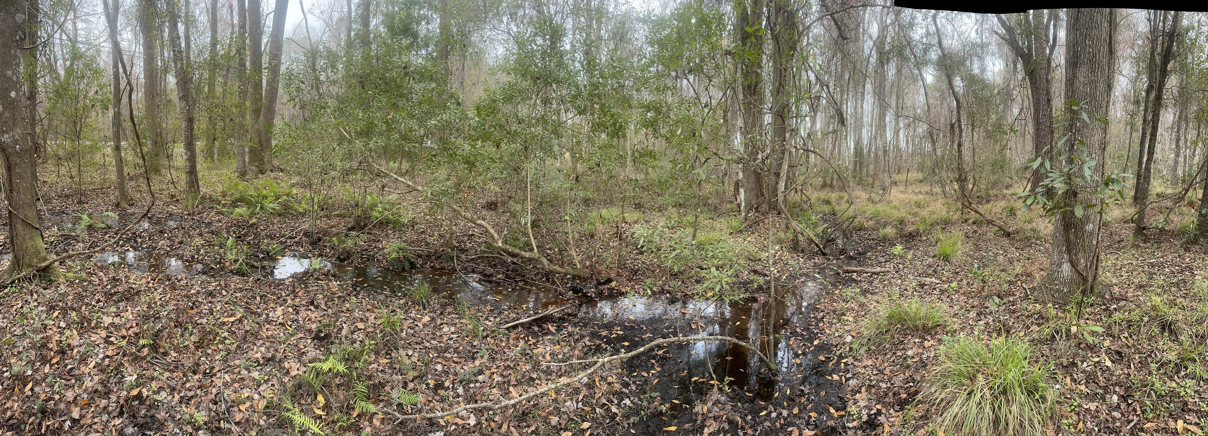
Wet
Dry
Stream 5:
Perennial streams and many ephemeral streams
A few depressions and one large wetland
Ground is damp
Longer saturated zone that transitions into tree
Would require the most resources
Stream 6:
No perennial streams
Fewer ephemeral streams
One noticeable major
Ground is dry
Short saturated zone with sphagnum moss, long grass/shrub zone
Easy to access
Steam 9:
No perennial stream
Experiences sheet flow post-rain events but no clear stream incisions
Ground is dry
Distinct ecotones
Short saturated zone/riverbank with sphagnum moss, zone with grasses/ shrubs that transitions to pine stands
Cons: challenging to access. Near road

Slide 11
Ecotone (Intermittently wet)
Concentration (mol/L)
Stream bank (Always wet)
Upland (Always dry)
DOC
CO₂
Distance from Stream

Slide 12
Upland (Always dry)
Stream bank (Always wet)
Ecotone (Intermittently wet)
Redox Potential
Distance from Stream

Slide 13
Stream
Upland (Always dry)
Stream bank (Always wet)
Ecotone (Intermittently wet)
Water Table Depth
Distance from Stream

Slide 14
Upland (Always dry)
Stream bank (Always wet)
Ecotone (Intermittently wet)
Rate (???)
Distance from Stream

Slide 15
Surplus
Stream DOC (mg/L) – Wetland DOC (mg/L)
Deficit
Periods of connectivity (days)

Slide 16
Surplus
Stream DOC (mg/L) – Known DOC Inputs(mg/L)
Deficit
Periods of connectivity

Slide 17
High Temp
c
c
High Temp
Greater Productivity
Low Temp
c
c
Reactor/Chimney
Low Temp
c
External Carbon
High Q
Low Q

Slide 18
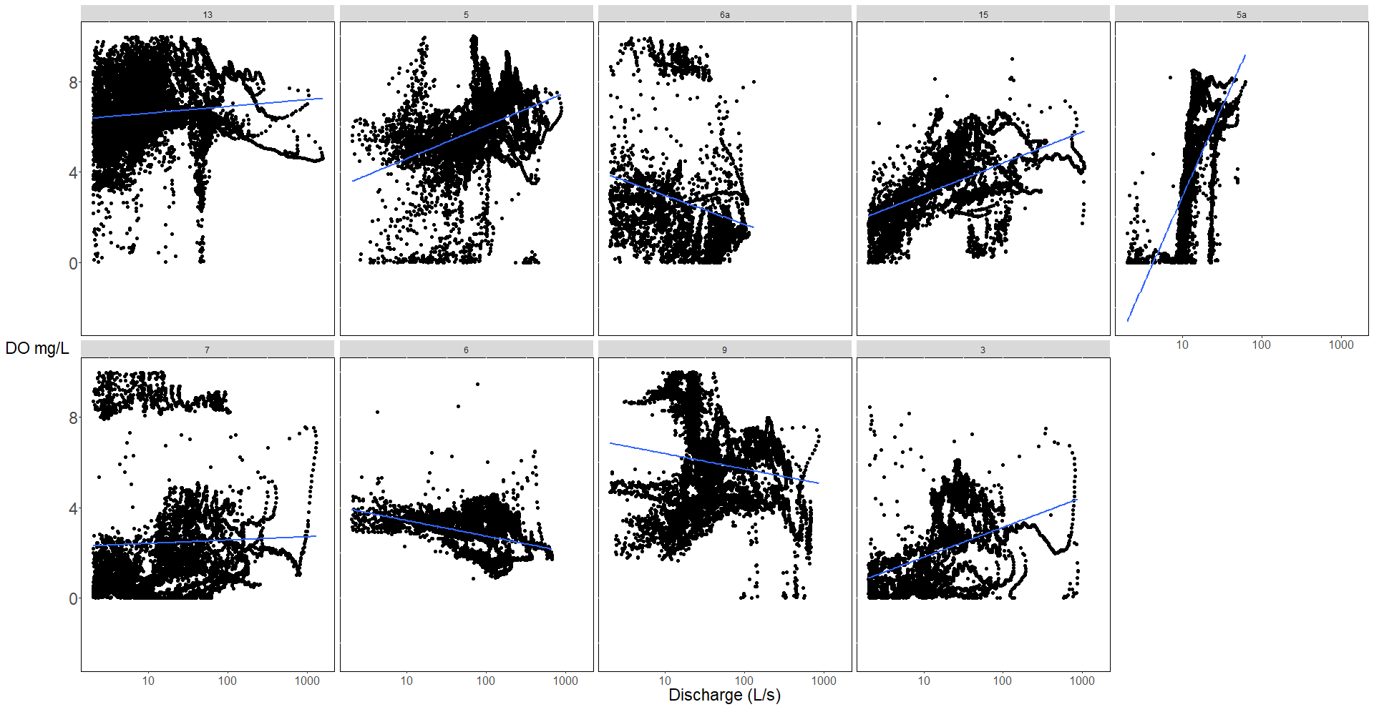

Slide 19
